Slide 1
Child Protection Hub for South East Europe
Working with Uncooperative Families – Reasons, Implications & Strategies – Webinar, July 9, 2015
by Stephanie Delaney

Slide 2
12 Suggested reasons why families are ‘uncooperative’
1.They do not want their privacy invaded.
2. They have something to hide.
3. They refuse to believe they have a problem (or do not understand the problem)
4. They resent outside interference.
5. There are cultural differences.
6. Parents lack understanding about what is being expected of them.
7. They have poor previous experience of professional involvement.
8. They resent staff changes.
9. They dislike or fear of authority figures.
10. Parents fear their children will be taken away.
11. They fear being judged to be poor parents (eg due to mental health / substance misuse)
12. They feel they have nothing to lose (e.g. where children have already been removed).

Slide 3
Conceptualising ‚Uncooperativeness’
Non – engagement – missing appointments, refusing to meet, changing the conversation
Disguised compliance – appearing to agree, but then not following up / taking actions, ‘making excuses’
Confrontational - arguing, complaining about services etc (might be legitimate!), questioning workers abilities
Hostility & Violence – including threats and actual violence

Slide 4
Implications
Uncooperativeness impacts upon:
The child
The family
The workers / professional networks
Implications
Ultimately can lead to, among other things:
Children being left in abusive situations / placed at increased risk
Families being denied appropriate support / facing more punitive actions
Workers feeling undermined, subject to violence in extreme cases
Splitting of the multi-agency team

Slide 5
For the child
‘Coping’ with their situation by accommodating, appeasing or identifying with their families as a way of keeping safer
Becoming de-sensitised to violence and abuse
Learning to appease and minimise - for example telling professionals everything is OK, appearing happy / smiling
Being too frightened to tell

Slide 6
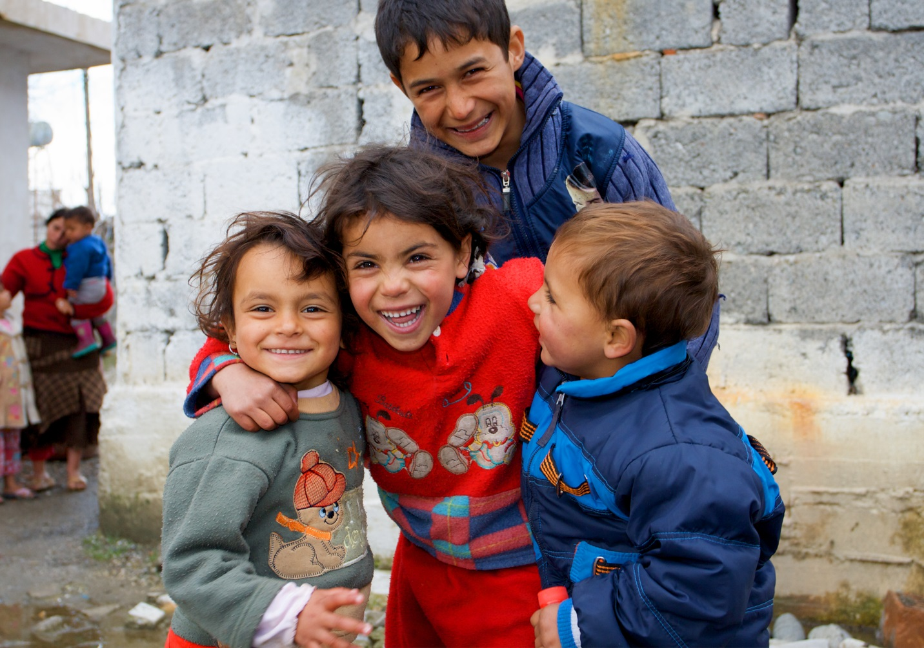
For the family
Increased tensions / violence within the family – including scapegoating
Being denied services / support or not given opportunity to change
Being subjected to punitive sanctions
Being unclear or confused about expectations of them
Involvement with police / legal procedures

Slide 7
For workers.
Feeling impotent and ‘useless’
Avoiding confrontation (eg ignoring or minimising issues, not seeing the child alone, not visiting)
Disengaging (eg being relieved when family not available, not proactively following up, ‘going through the motions’)
Mirroring the families behaviour (eg being aggressive, critical, negative)
Being over optimistic OR negative
Being hyper-alert (fear getting in the way of judgement)
In extreme cases, experiencing violence (against selves or possessions)
‘Splitting’ of the multi-agency group – leading to divisions

Slide 8
Key considerations
What are the implications for the child? What messages are they getting from the position of the workers and the uncooperativeness of the family?
What impact is the behaviour / attitude of the workers and how is this influencing uncooperativeness?
What is the role of the multi-agency team in supporting uncooperativeness?
Is specialist help or advice needed to be able to work more positively with the family? (eg drug and alcohol, learning disability, mental health)
Do arrangements need to be made to keep workers safe? (eg joint visits, neutral venue, police etc)

Slide 9
Strategies (1)
Try to understand the underlying reason / reasons for the uncooperativeness – this may help with finding an appropriate solution
Think about entry points and mediators (eg other members of family / community who may be more positive or other workers who family has relationship with)
Provide information - Be clear about role and responsibilities, and provide information in appropriate ways (eg leaflets etc) including complaints mechanisms
Use written agreements so families are clear about expectations
Review action plans more frequently to avoid drift, splitting and share information
Consider venue and location for meetings, but don’t avoid engagement
Strategies (2)
Make sure the child is regularly seen in private
Think about the most appropriate worker to see family (eg another member of multi-agency team)
Consider whether it is appropriate to change worker
Use supervision / peer support to help workers process feelings / opinions and reactions to ensure balanced and appropriate
Be open and transparent about uncooperativeness and its implications (Challenge families about behaviour in neutral way)
Develop safety plans for workers if necessary
Document all incidents and ensure records are kept up to date
Test commitment

Slide 10
CASE 1
A mother is constantly late for appointments, never at home for visits. She has previously had a child taken into care due to neglect (at the time she was misusing drugs). The mother is very nice, but cries whenever challenged about not being available to meet with workers. She says that she is worried about being judged. School have reported the family as they are concerned about the delayed development of her 5 year old son.
What do you think might be a suitable approach to trying to engage the mother, and dealing with her uncoopertiveness?

Slide 11
Case 2
A family has two children aged 9 and 11 years old. The children do not go to school and are often seen begging on the streets. Workers has visited the family who deny that there is any problem. The parents do not understand why Social Services are concerned.
What do you think might be a suitable approach to trying to engage the family, and dealing with thier uncooperativeness?

Slide 12
Child Protection Hub for South East Europe
Nurturing a safe environment for children
www.childhub.org

