Slide 1
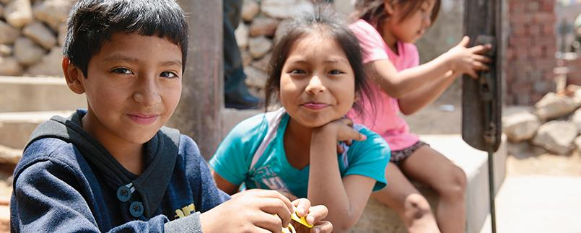

©Tdh/J.Löb - Peru
Facilitating child protection and safeguarding activities with children and adolescents

Slide 2

Welcome and Introduction of participants
Notes:
Resource : stick and stones

Slide 3

Expectations for this TOT ?

Slide 4

Pretest
Notes:
Give a number to the participants to write on their pre test- They will have also to write the same number on the post test

Slide 5
Objective and structure of the TOT
Overall objectives
Equipping facilitators and trainers in child protection field with the necessary knowledge and tools to involve children in their own protection, allowing them to provide interactive and creative sessions to children and youth and to raise their awareness about child safeguarding and ensure they know where to go for help.
Structure
Day 1
  Foundations on Child protection and safeguarding and participation
  Why & How to Involve Children in their Protection?
  Specific skills for facilitators facilitating activities on CP for children and adolescents
Presentation of the curriculums
Day 2
  How to make Participation safe?
  Practice facilitation of the children and adolescents sessions

Slide 6
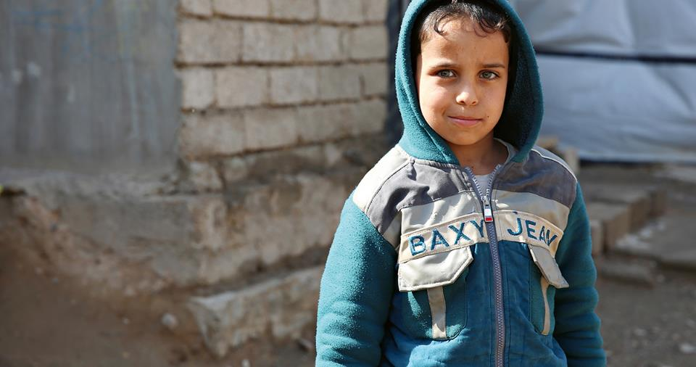
©Tdh/J.Löb - Iraq
Foundations _ Child Protection
Lausanne, 01.09.2019 - ABC

Slide 7
The difference between Child Protection and Child Safeguarding
Child protection = External or outside the organisation – children abused in their families and communities.
Child Safeguarding = Internal or inside the organisation – children abused or put at risk by trusted adults (or other children) within the organisation.

Slide 8
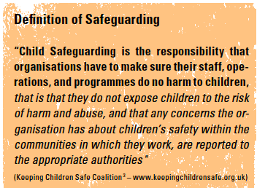

Slide 9
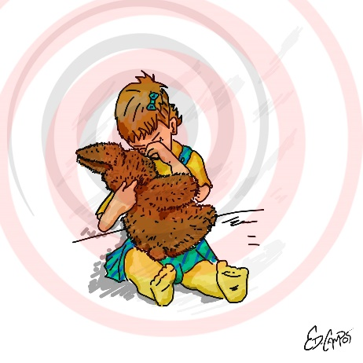
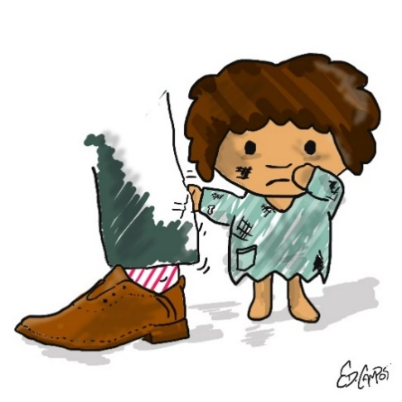
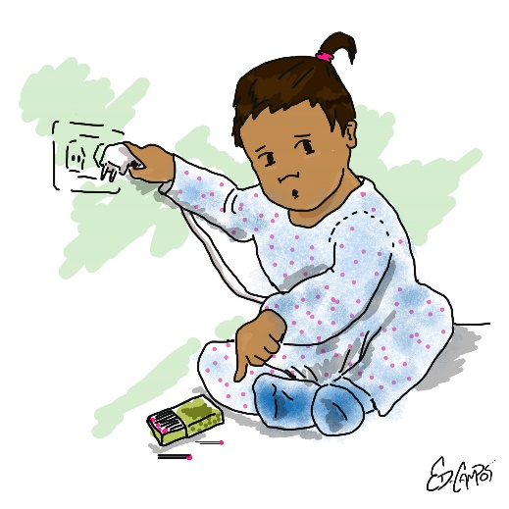
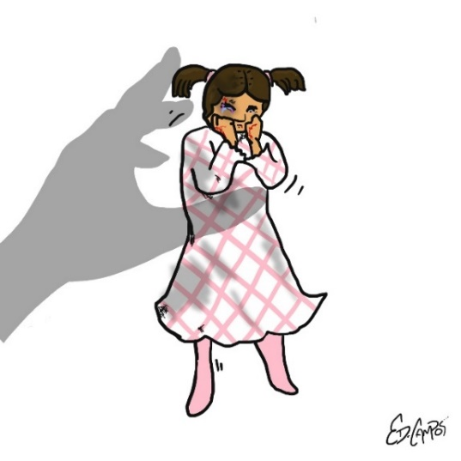
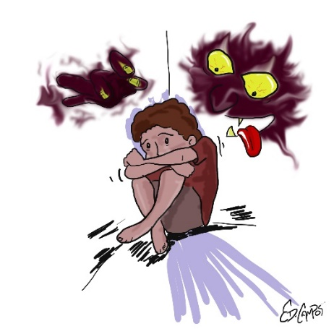
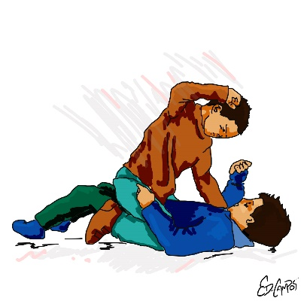
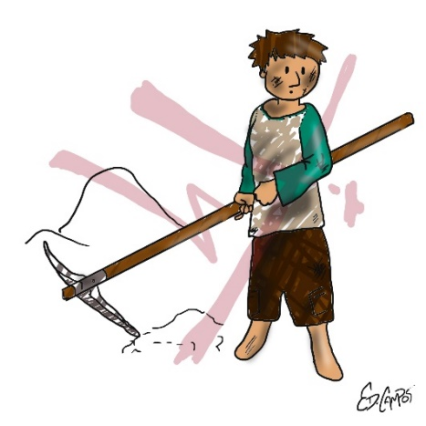
Different types of violence against children- different abuse
Physical abuse
Emotional abuse
Sexual abuse
Neglect
Exploitation
Peer on peer abuse
Safety and security risks
Forced criminality

Slide 10
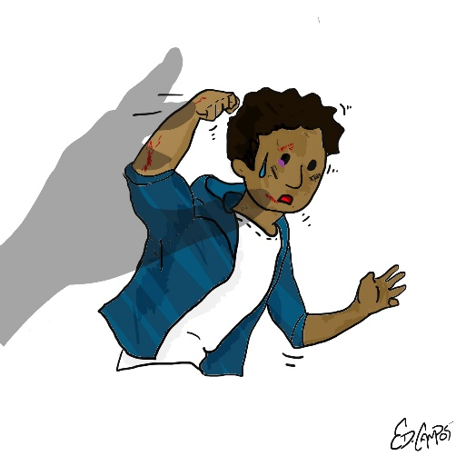

Physical Abuse
is deliberately hurting a child through violent physical force so as to cause actual or likely physical injury or suffering, e.g.
Biting
Pinching
Shaking
Throwing
Poisoning
Burning or scalding
Drowning or suffocating a child

Slide 11
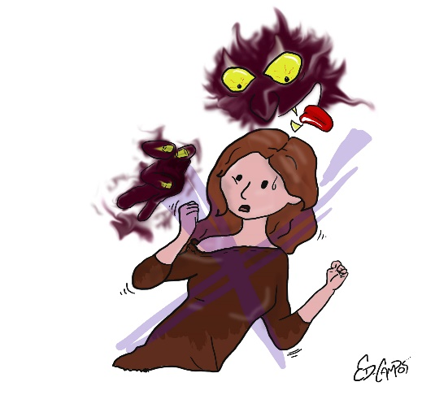
Sexual abuse
Sexual Abuse occurs when others use and exploit children sexually for their own gratification or gain or the gratification of others.
May involve physical contact, incl. assault by penetration (for example, rape, or oral sex) or non-penetrative acts such as masturbation, kissing, rubbing and touching outside clothing. It may include non-contact activities (ie. involving children in the production of sexual images, forcing children to look at sexual images or watch sexual activities), encouraging children to behave in sexually inappropriate ways or grooming a child in preparation for abuse.

Slide 12
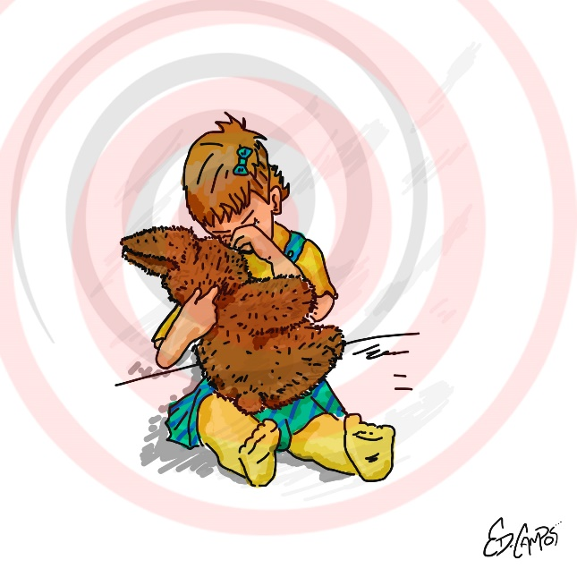
Emotional abuse
is the persistent emotional maltreatment of a child. It is also sometimes called psychological abuse and it can have severe and persistent adverse effects on a child’s emotional development.
Emotional abuse may involve:
deliberately telling a child that they are worthless, or unloved and inadequate.
It may include not giving a child opportunities to express their views
deliberately silencing them
or ‘making fun’ of what they say or how they communicate.

Slide 13

Neglect
Failure to identify and meet the needs of a child, for example by ignoring medical, emotional or physical care needs, failing to provide access to appropriate health, care and support or educational services or withholding of the necessities of life, such as medication, adequate nutrition and heating.

Slide 14

Exploitation
Exploitation is the intentional ill-treatment, manipulation or abuse of power and control over a child or young person; to take selfish or unfair advantage of a child or young person or situation, for personal gain. It may manifest itself in many forms such as child labour, slavery, servitude, engaging in criminal activity, begging, benefit or other financial fraud or child trafficking. It extends to the recruitment, transportation, transfer, harbouring or receipt of children for the purpose of exploitation. Exploitation can be sexual in nature.

Slide 15

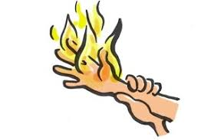
Safety and security
Risks of a child harming her/himself or facing health problems at our places of activities are also to be taken into account in our risk analyses.

Slide 16
Exercise to work on Child protection risks and signs of Child abuse
In groups of 5 discuss which are the possible indicators of a child in danger and try to complete the table below
Forms of Abuse | Behavior towards children that might constitute an abuse | Indicators of this form of abuse
Physical
Emotional
Sexual
Neglect

Slide 17
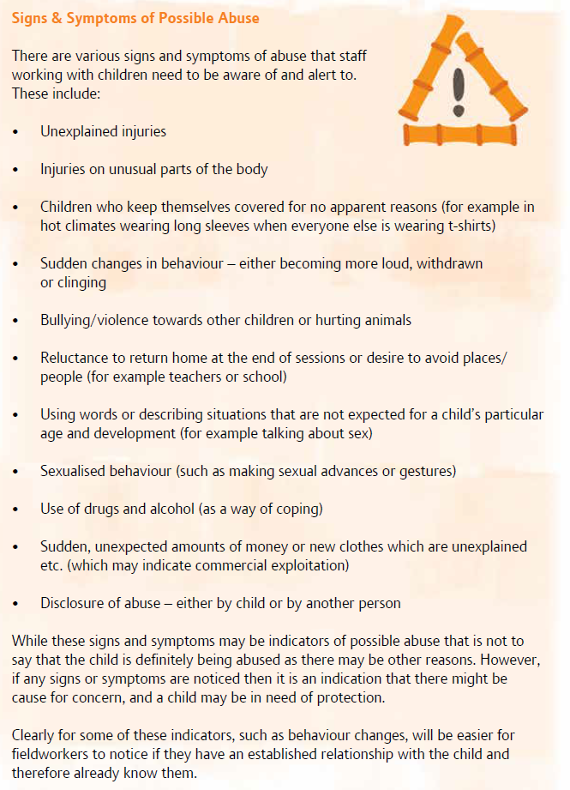
Signs and indicators of abuse

Slide 18
Distribute handout 1

Slide 19


Child protection risks faced by refugee and migrant children in Greece
Notes:
Group work / brainstrorming
working with a human rights-based approach to development, believes that it is important to adopt a culturally sensitive approach to child protection. This requires and creates opportunities to work with children, families and communities to identify ways to protect children which make sense for them; and create a cultural ‘fit’ rather than having ideas imposed from outside. This is especially important for community-based work,

Slide 20
Importance of Referral
What is a referral ?
The process of connecting a child to a specific service provider to address an identified need. (It can also imply formally requesting services for a child or their family from another agency (e.g. cash assistance, health care, etc.) through an established procedure and/or form)
What is a referral pathway ?
A list of available services to be contacted according to identified needs of the children that need additional support.

Slide 21
Referral Pathway for your site / area
Do you have one for your site / area ?
What is your role in the referral (refer directly the child to appropriate service or refer to a CP focal point of your organization first?)
What is the process (form to fill, oral contact?)

Slide 22
Why & How to Involve Children in Their Protection ?

Slide 23

Balloon game !

Slide 24


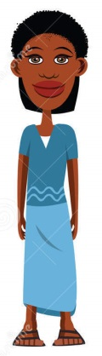
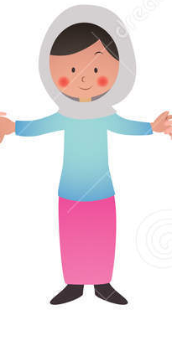
What is participation ?
Notes:
8) Child -initiated, shared decisions with adults is when projects or programs are initiated by children and decision-making is shared among children and adults. These projects empower children while at the same time enabling them to access and learn from the life experience and expertise of adults.
7) Child -initiated and directed is when young people initiate and direct a project or program. Adults are involved only in a supportive role.
6) Adult-initiated, shared decisions with children is when projects or programs are initiated by adults but the decision-making is shared with the young people.
5) Consulted and informed is when children give advice on projects or programs designed and run by adults. Children are informed about how their input will be used and the outcomes of the decisions made by adults.
4) Assigned but informed is where children are assigned a specific role and informed about how and why they are being involved.
3) Tokenism is where young people appear to be given a voice, but in fact have little or no choice about what they do or how they participate.
2) Decoration is where young people are used to help or "bolster" a cause in a relatively indirect way, although adults do not pretend that the cause is inspired by children.
1) Manipulation is where adults use children to support causes and pretend that the causes are inspired by children
Promotion of child’s participation
as a goal to increase fulfilment of children’s rights to participation and to promote children’s active role in society as social actors, citizens and protagonists.
as a principle that should be considered in each stage of programming, and in different thematic areas of work.
as a means to secure their rights to survival, development, protection and participation.

Slide 25
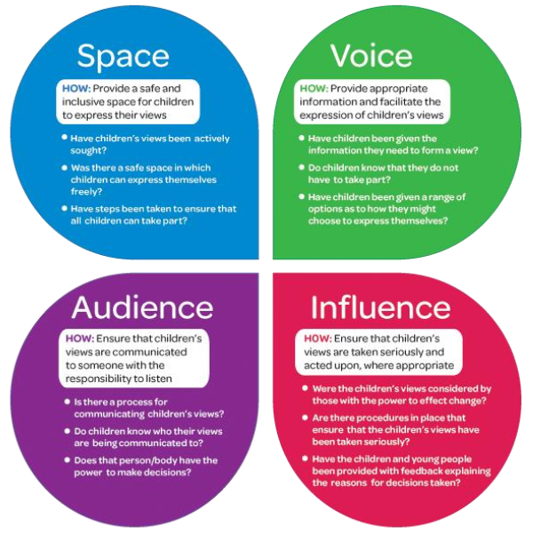
What is participation ?
Notes:
8) Child -initiated, shared decisions with adults is when projects or programs are initiated by children and decision-making is shared among children and adults. These projects empower children while at the same time enabling them to access and learn from the life experience and expertise of adults.
7) Child -initiated and directed is when young people initiate and direct a project or program. Adults are involved only in a supportive role.
6) Adult-initiated, shared decisions with children is when projects or programs are initiated by adults but the decision-making is shared with the young people.
5) Consulted and informed is when children give advice on projects or programs designed and run by adults. Children are informed about how their input will be used and the outcomes of the decisions made by adults.
4) Assigned but informed is where children are assigned a specific role and informed about how and why they are being involved.
3) Tokenism is where young people appear to be given a voice, but in fact have little or no choice about what they do or how they participate.
2) Decoration is where young people are used to help or "bolster" a cause in a relatively indirect way, although adults do not pretend that the cause is inspired by children.
1) Manipulation is where adults use children to support causes and pretend that the causes are inspired by children
Promotion of child’s participation
as a goal to increase fulfilment of children’s rights to participation and to promote children’s active role in society as social actors, citizens and protagonists.
as a principle that should be considered in each stage of programming, and in different thematic areas of work.
as a means to secure their rights to survival, development, protection and participation.

Slide 26
Distribute handout 1.a

Slide 27
Factors Influencing Involvement in Protection: influence of Age, Development & Individual Characteristics
Age
Experiences of Childhood – including previous abuse
Disability
Gender
Environment
Links between Age, Development & Abuse
Notes:
Age
as the child grows and their cognitive and verbal capacities increase, the possibilities to include them in protection becomes easier. This is the case for
children who may be considered too young to be involved. Studies have shown that even young children can be effectively taught self-protection skills and are
able to identify other children who are suffering abuse
Experiences of Childhood – including previous abuse
The unique individual experiences of each child will also impact upon the possibilities for them to be involved in protection. Children who do not feel confident and valued may find it more difficult to participate. Similarly those children who have never felt listened to may find it hard to share their ideas.
Children who have been abused are a particular concern. It is not unusual for children who have been abused over a long period of time, sometimes by those who are supposed to love and support them, to begin to regard this as normal (even though they may not like it). They may rationalise what has happened as a way of coping and not identify themselves as victims. For example, this may be the case if they have been commercially sexually exploited.
Addressing children’s rationalising is difficult, as it is not helpful to remove children’s ways of coping, unless we can find other ways to help them manage their experiences. Trying to persuade children that they are victims can be counterproductive to building positive and trusting relationships, and it can be damaging, as it can remove whatever self-esteem the children have developed.
A much more useful approach is to accept what a child says, but to offer an alternative view that in time the child may accept.
Disability
To engage children with disabilities it is important to be able to identify those children as they are often isolated or kept separate from the general population of children. We may also need to overcome negative ideas about the capacities of children to participate, sometimes from adults, such as parents, who want to protect their child, but may have a limited idea about their potential.
The inclusion of children with disabilities may have implications for practical and logistical arrangements, such as needing to make sure that buildings are accessible and transport is provided. We may also need to learn different ways or make special arrangements for communication, for example sign language.
The variances of disability and the extent to which this impacts on a child’s life, and their ability to participate in their own protection, is reflected by the wide range of disabilities which include cognitive and/or physical disabilities and can be classified as mild, moderate, severe or profound – all relating to the extent that a child is affected and the support they need.
Gender
Boys and girls experience childhood differently. This includes both their experiences of being a child and the nature of violence that they can encounter. This may be for a number of reasons that can either disadvantage girls or disadvantage boys, such as the persistent belief or assumption in some cultures that boys cannot be sexually abused. The pattern of abuse that boys and girl face also may differ. For example, in cultures where girls are more restricted, they may be more vulnerable to abuse within the family and less likely to be able to access services for support.
Different expectations about boys and girls and their role in society in general, and in their roles in communities and families specifically can result in situations where girls are discriminated against and denied access to their rights, making them more vulnerable to abuse as children and as adults. For example, not being able to go to school can lead to economic reliance on husbands and families. In some contexts it may be difficult to ensure that girls are able to participate in activities – especially as they get older
It is especially important when working with children to explore how protection and abuse is experienced by boys and girls to ensure that strategies meet the needs of both.
Environment
Strongly linked to the factors of age, disability and experience of abuse are other wider social and cultural factors that shape the environment for children, and the extent to which they are valued and protected. This includes issues such as gender discrimination, and other harmful traditional practices and customs.
The extent to which children’s views and opinions are encouraged and valued, and to what degree they are seen as individuals with rights, also influences the extent to which children are able to participate in their own protection. This requires a careful assessment of the community (and perhaps sensitisation and awareness raising) to be able to ensure that the involvement of children can be carried out safely.

Slide 28
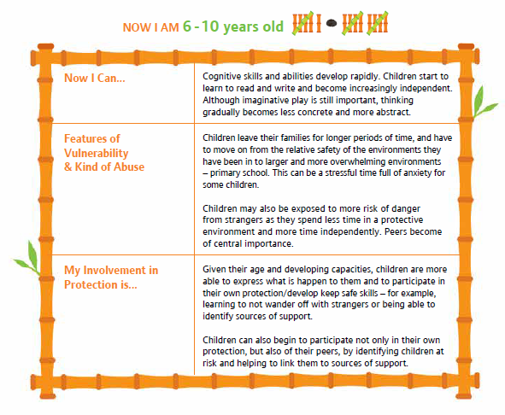
Age characteristics
Notes:
Resource :stick and stones

Slide 29
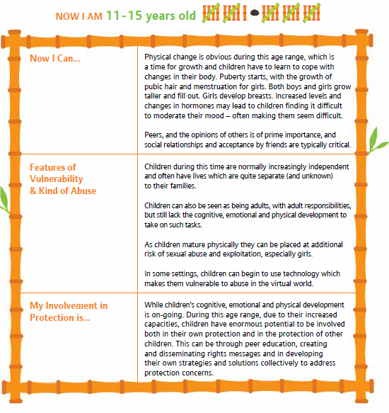

Slide 30
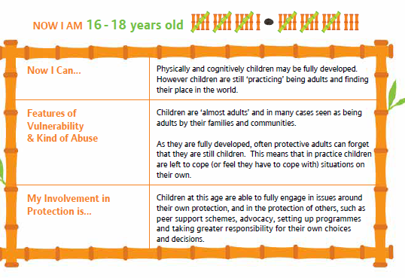

Slide 31
Distribute handout 3

Slide 32


Why & How to Involve Children in Their Protection?
WHY ?
UNCRC
Increase Resilience
Strengthen the protection system
HOW ?
The development of self-protective behaviors
Increase personal safety
The participation of children in program responses(i.e identifying risks )
Advocacy by children
The involvement of individual children in decisions relating to
their own protection
It is not a one off activity !!!!
.
Notes:
KEY MESSAGES
Children have a right to protection and participation.
• Participation is an important element of child development in terms of increasing children’s resilience, helping them to maximise their full potential and to grow successfully into competent and capable adults.
• While the responsibility for protecting children remains with adults, adults cannot always been present – children also need to be able to protect themselves.
• The involvement of children in protection issues is an important element in supporting the development of national children can give additional insight into realities of protection
=>Self-protective behaviours include personal safety but also further considers what children can do to avoid or react appropriately in situations of abuse, specifically focusing on child protection
1st + 2nd and eventually 3rd ( to check) type of objectives / reasons proposed are targetted in the curriculum sessions proposed
Development of self-protective behaviours is a skill that carries children through childhood and into adult life.
• Participation is both a right for children and essential for their development.
• Children may have very different perspectives on protection and risk, and without including these views we miss opportunities to effectively promote the protection of children.
• However effective the protection that adults provide for children, adults will never be able to guarantee the safety of children 24 hours a day, every day of the week, especially as children grow up and become more independent.

Slide 33
Pre- requisite before starting activities involving children and adolescents in their own protection
A risk assessment must be carried out prior to starting any activities with children to ensure that they are not placed at additional risk as a result of their engagement
Safeguarding policy
Informing caregivers and obtaining consent
=> Careful assessment of the environment and preparation of Communities may be necessary to ensure that children are not put at additional risk as a result of their participation.
Notes:
Children’s participation should be discussed with families and communities in advance of activities taking place to ensure that adults are supportive of the initiative. This is especially important when discussing protection issues, and particularly sexual abuse, in contexts where such topics are considered private and taboo.
Example of risk assessment : handout 3

Slide 34
Principles when exploring protection with children and empowering them to be active agents of their own protection
Non-discrimination and inclusiveness – treating all people equally and including everybody.
Democracy and equality of opportunity – giving everyone the same chances, and allowing all people to have their say.
Physical, emotional and psychological safety of participants – making sure that everyone is looked after, that nobody is harmed (‘Do No Harm’) and that the best interests of the child are prioritized.
Adult responsibility – although children’s voices are important and children have skills, it is an adult role to ensure that children are safe.
Voluntarism, informed consent and transparency – children should be asked if they want to take part, understand what they are agreeing to do and know what will happen as a result.
Participation should be an enjoyable and stimulating experience – even if it is a serious topic or issue, Participation should remain a choice, and it does not have to be boring!
‘Child-friendly’ - enabling children to contribute to the best of their abilities
Notes:
Resource : stick and stones
Action oriented discussion

Slide 35
Perception of risks and abuse by communities and children
Challenge: Developing a shared sense of what constitutes
child abuse: what is acceptable and what is not acceptable…
Culturally sensitive approach
There are many valid ways of looking after children, it is equally important not to ‘excuse’ or justify forms of abuse because they are culturally or locally acceptable, as this could leave children at great risk
Children’s perception
not been given enough information
not aware of their rights, and/or the situations they face are so common that they seem ‘normal
Minimizing risks as a coping reaction
Notes:
Culture and Abuse – Including Harmful Practices
Some manifestations of abuse, including harmful practices (even if they are widely accepted and sanctioned in the community as part of tradition), are obviously damaging for children and clearly infringe their rights to protection. Other forms of abuse are more related to the meaning for the child of their experiences. This is both in terms of the way children make sense of what has happened and also how it affects their development. For example, rape is a clear example of sexual abuse, but shouting at a child does not always constitute emotional abuse. It depends on who is shouting, what they are sa
working with a human rights-based approach to development, believes that it is important to adopt a culturally sensitive approach to child protection. This requires and creates opportunities to work with children, families and communities to identify ways to protect children which make sense for them; and create a cultural ‘fit’ rather than having ideas imposed from outside. This is especially important for community-based work,
ying and how often they do it.
While recognizing that there are many valid ways of looking after children, it is equally important not to ‘excuse’ or justify forms of abuse because they are culturally or locally acceptable, as this could leave children at great risk. A culturally sensitive approach to child protection is needed, which relies upon workers having a clear understanding of child abuse and protection, including an appreciation of when to seek support and/or make a referral.
There are a number of reasons why children may have different perspectives to adults. Children, especially younger children, may not have been given the opportunity to think about dangers or not had the chance to think through consequences. This can be a result of their more limited experience of the world, their developmental stage, or because they have not been given enough information. In addition, they may not be aware of their rights, and/or the situations they face are so common that they seem ‘normal’. For example, if a child grows up being constantly hit, they may not like it, but they may not see it as being anything unusual.
Even when children have been given opportunities to explore what protection means, they may still not agree with adults. This can be especially so when children are used to coping, or have different priorities. For example, children who live on the streets often face abusive situations, but at the same time can feel empowered because they rationalize what is happening or believe that they are taking care of themselves.
It is critical that we understand what children think about protection to be able to effectively protect them. If we design programs and interventions that do not make sense for children or do not fit with their realities, children will not access them or they will not be effective. This does not mean that we automatically accept children’s views of their need for protection – or the lack of it – but we need to work with them to explain why adults may have different ideas. Another practical reason for including children’s perspectives of protection is that, while they may not recognize some risks well known to most of the adults, they are aware of the risks they face on a daily basis – things that adults may overlook. For example, adults might be most concerned about trafficking (a serious issue, but relatively unlikely in most settings) whereas children may be more concerned about being hit by their teacher. Part of understanding children’s perspectives on protection is to be able to give children definitions in ways that can be understood.

Slide 36
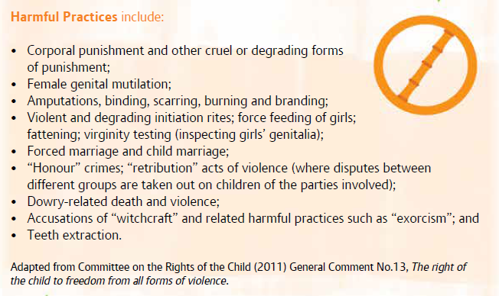
Harmful practices

Slide 37
Key messages
Age, development and individual circumstances all affect the risks that children face and extent to which children can be involved in their own protection.
Environment and context within which a child lives impact upon the extent to which children can participate in protection issues and need careful assessment to ensure the children are not placed at greater risk.
Even very young children can begin to become involved in their own protection, and in the protection of their peers.
Girls and boys may face very different risks and this needs to be explored to ensure both boys and girls are adequately protected.

Slide 38
Distribute handout 2

Slide 39
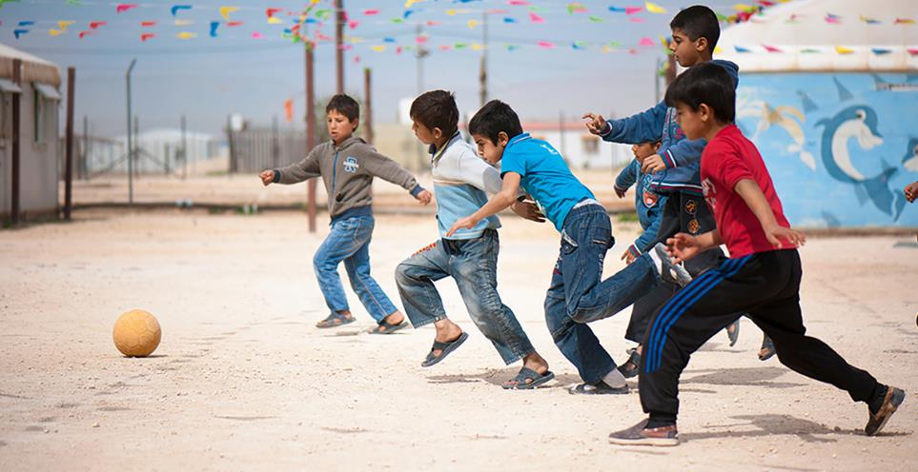
©Tdh/O.Girard - Jordan
Characteristics of the facilitator leading children’s activities on child protection and safeguarding

Slide 40
Group Activity: Agree or Disagree?
A facilitator should have a good knowledge of the topic and be the expert.
Facilitators' task is to encourage the people to come to the meetings.
As a facilitator I always welcome participants who are late.
The role of a facilitator is to be a catalyst.
If somebody is provocative, as a facilitator, I ignore it.
A facilitator should have ethical principles.
The role of a facilitator is to be a coach.
A facilitator shouldn't have to be also a mediator.
The facilitator is the leader of the meeting.
The focus of facilitation is on learning/knowledge.
The role of a facilitator is to be a conductor.
Notes:
Participants will move to Agree or Disagree corner/side depending on their point of view concerning the statements

Slide 41
Defining Facilitation
“Facilitation is the art of leading people through processes towards agreed-upon objectives in a manner that encourages participation, ownership and creativity by all those involved”
and so..
Facilitator is the “person that makes an action or process easy or easier”.

Slide 42
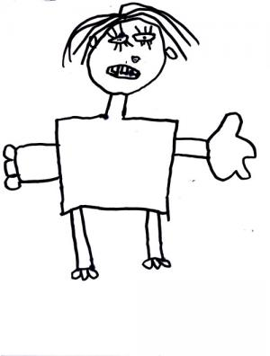
Notes:
Is a good listener, and is able to respond to participants’ needs and to situations as they arise.
Is sensitive and helps all children feel safe, respected and valued.
Creates a warm and inviting atmosphere where everyone feels welcome.
Does not discriminate
Encourages and actively facilitates participation on the part of everyone
Being patient, giving gentle encouragement and allowing children to go at their own pace normally works!
Notices children’s learning and increasing skills and gives feedback on this to encourage confidence.
Is aware of the energy levels of the children, and if they seem tired because they have been working hard or they are getting restless and bored, stops what they are doing and plays an energiser or takes a break.
Is able to motivate and actively challenges participants to think.
Provides guidance and leadership as necessary ,but is not dominant and does not need to be the center of attention.
Is ready to refer children to suitable sources of help and support
Comments on behavior rather than a particular child, and does not judge too quickly.
Is flexible and able to adapt to the needs of participants but at the same time keeps in mind the time and purpose of the course.
Keeps a sense of the whole workshop in his or her head and is able to guide participants through it, making links as appropriate.
Models the behavior expected by the participants, and sticks to any agreement or ground rules made by the group.
Is organized and makes sure that all practical arrangements have been made.
Has a sense of humor and is fun.

Slide 43
Good listener
respectful
Good communicator
patient
sensitive
Manages group dynamics
inclusive
Applies Non-directive intervention
motivator
Organized and well prepared
flexible
Sense of humour
Enjoys
the process
Gauge the energy level of the group
Affirming to everyone's knowledge
Notes:
Is a good listener, and is able to respond to participants’ needs and to situations as they arise.
Is sensitive and helps all children feel safe, respected and valued.
Creates a warm and inviting atmosphere where everyone feels welcome.
Does not discriminate
Encourages and actively facilitates participation on the part of everyone
Being patient, giving gentle encouragement and allowing children to go at their own pace normally works!
Notices children’s learning and increasing skills and gives feedback on this to encourage confidence.
Is aware of the energy levels of the children, and if they seem tired because they have been working hard or they are getting restless and bored, stops what they are doing and plays an energiser or takes a break.
Is able to motivate and actively challenges participants to think.
Provides guidance and leadership as necessary ,but is not dominant and does not need to be the center of attention.
Is ready to refer children to suitable sources of help and support
Comments on behavior rather than a particular child, and does not judge too quickly.
Is flexible and able to adapt to the needs of participants but at the same time keeps in mind the time and purpose of the course.
Keeps a sense of the whole workshop in his or her head and is able to guide participants through it, making links as appropriate.
Models the behavior expected by the participants, and sticks to any agreement or ground rules made by the group.
Is organized and makes sure that all practical arrangements have been made.
Has a sense of humor and is fun.

Slide 44
General Facilitation Techniques & Tools Questioning for enhancing participation
Hypothetical questions: “What would you do/think if...?”
Speculating: “How might we help to solve this problem?”
Encouraging/supporting: “That’s interesting, what happened next?”
Opinion seeking: “What do you think or feel about...?”
Probing: “What makes you think that?”
Clarifying/summarising: “Am I right to say that you think...?”
Identifying agreement: “Do most of us agree that...?”

Slide 45
General Facilitation Techniques & Tools for enhancing participation of children and adolescents
Role Playing
Pairs and small groups
Idea storming ( brainstorming /mental shower)
Whole group discussion
Questioning 
“Buzz session”
Drawing
Pictures and photographs
Video
Newspapers and magazines

Slide 46

Specific Skills and Knowledge that is required for facilitating child protection topics with children
Address difficult and embarrassing topics in a sensitive way.
Use language that is appropriate for the age and developmental stage of children in a non-threatening way.
Know how to handle disclosures in a supportive and appropriate way.
Deal with strong emotions and feelings.

Slide 47
Specific Skills and Knowledge that is required for facilitators
Give clear messages to children about their rights to protection, and what is and is not appropriate behavior.
Discuss issues around personal boundaries and inappropriate touch in a calm and clear way.
Share their concerns and seek and receive support and supervision when necessary.
Appropriately manage confidentiality.
Notes:
Activity: Find the other parts of the sentence- Create the full sentence-Discuss with the team

Slide 48
Distribute handout 4

Slide 49
©Tdh/O.Girard - Jordan
Curriculum for children and adolescents

Slide 50
Presentation of the curriculum
Main objectives
Overall, the training aims to build and strengthen the capacities of children in their involvement in their own protection.
By the end of the course it is expected that children will:
Have a brief awareness of child rights
Have explored feelings associated with being safe/not safe
to identify situations that are safe and those where personal safety may be at risk.
Have identified simple strategies for keeping safe e.g. say 'no', get help
Have Identified people who help to keep us safe throughout the day
Explore appropriate personal safety strategies
Notes:
Starting any work involving children in their own protection needs to include two aspects: raising children’s awareness of their right to be protected and exploring with children what protection means to them, meaning what they consider to be risks and dangers. A shared understanding by children and adults of what children are being protected from is the basis for building agreement on the best ways to develop initiatives, programmes and systems to protect children

Slide 51
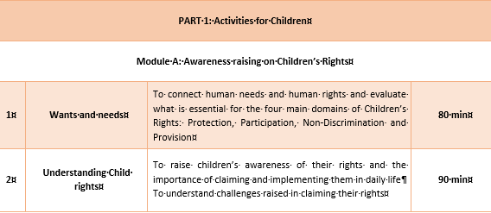
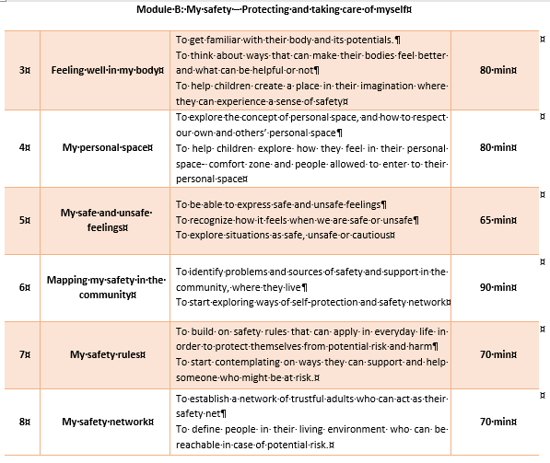
For children
( 8-12y.o)
2 modules
8 sessions

Slide 52
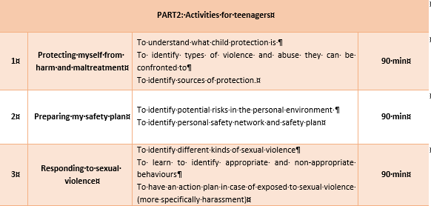
For adolescents (13-18y.o)
3 sessions

Slide 53
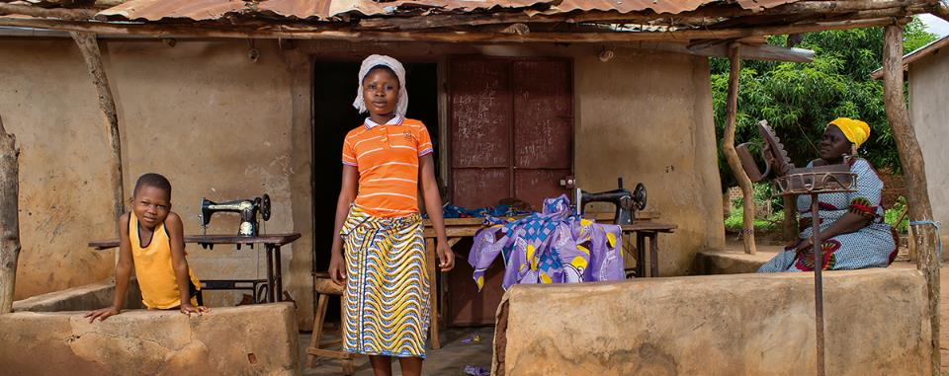
©Tdh/P.Robin - Benin
Getting ready to train

Slide 54
Preparation for experimentation of day 2
Objectives
Practice the facilitation of the proposed children / adolescents sessions so as to be better equipped to train others on the curriculum and
Practice feedback as an approach to support skills development for future facilitators
Organization
Participants will be by group of 2
2 sessions will be managed on day 2
Each “ pair” selects one session/ exercise from the curriculum and prepare to deliver the session tomorrow
Other Participants will play the role of children/ adolescents but will also provide feedback to the “ trainers” in order to exchange and share good practices (skills, attitudes adapted to the topic, safe participation, managing group / time)
Some “ children “ will be given specific roles as to put the “ facilitator” in real life situation

Slide 55
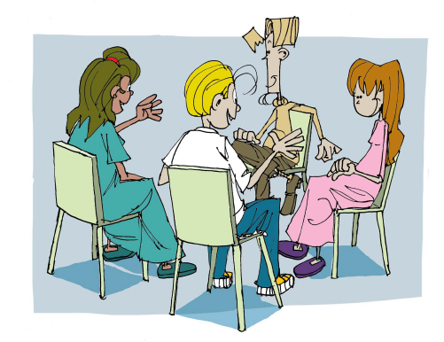
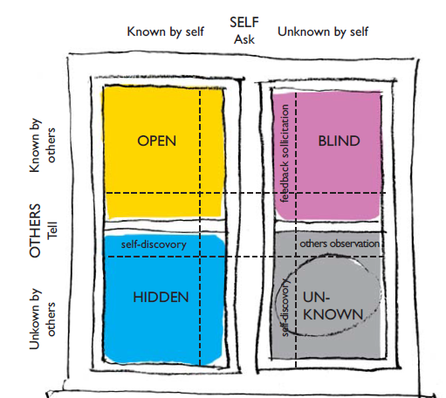
Steps for feedback
1 The main actors (the facilitators) say in turn how they feel and what they thought about their session
2. The members of the group who participated as ‘the children’ or who observed a session with children, each prepare one positive point and one improvement, with suggestions for the improvement.
3. The trainer finishes up with any points which may possibly have been forgotten
4. The word is given back to the animators who say what were the two important points they recall from the feedback, and how they feel after hearing them.
Notes:
How to give effective feedback?

Slide 56
Distribute handout 7

Slide 57
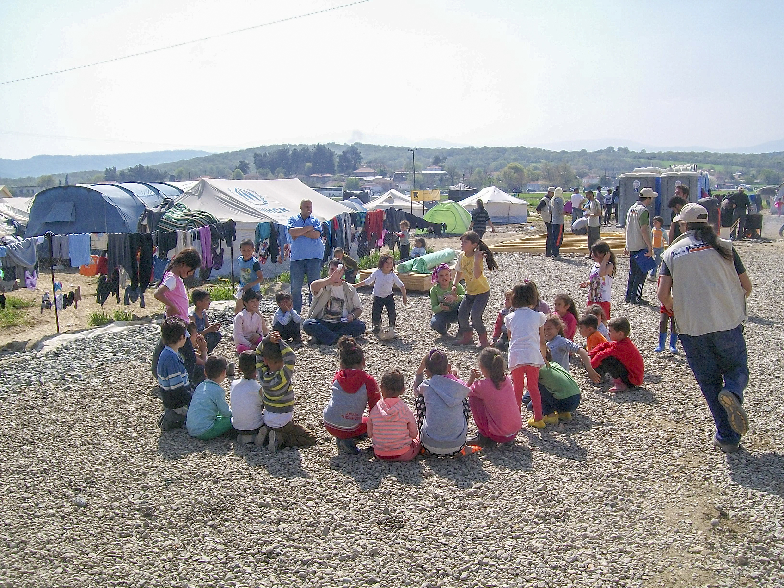
Demonstration of one session of the curriculum

Slide 58
Prepare your session for tomorrow
Read carefully the session
Ask questions to trainers in case anything is not clear
Divide the roles
Make sure you have the material

Slide 59

Welcome and recap

Slide 60
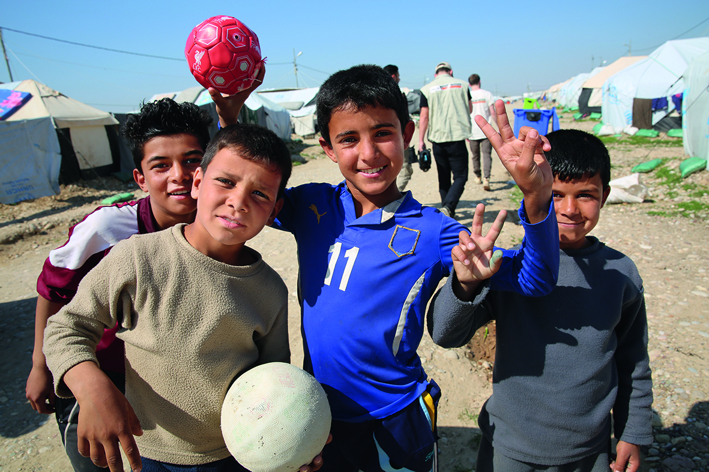
©Tdh/Joakim Löb - Irak
Making participation safe

Slide 61
Making participation safe
It can range from very practical things, to ensuring that children are protected from abuse.
All facilitators should have agreed on the Code of Conduct and Safeguarding Policy and they must take responsibility for ensuring that their own behavior does not abuse children physically, sexually, emotionally or mentally, and to do all they can to protect children.

Slide 62
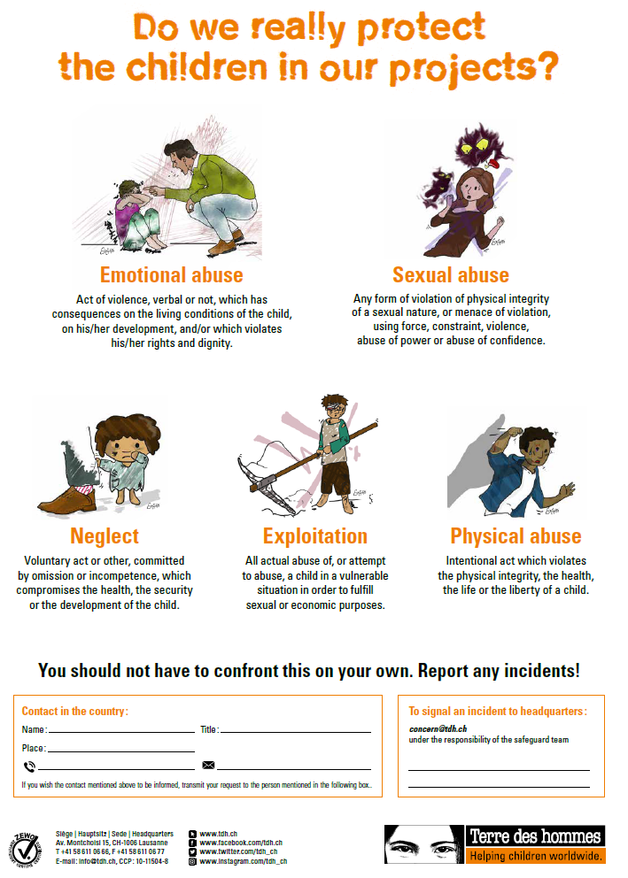
Internal safeguarding code of conduct !
Notes:
Resource : psychosocial training toolkit

Slide 63
Safeguarding policy
Trainers need to be familiar with situations that may present risks and learn how to deal with these or minimize their impact.
Although it is recommended that children are given the opportunity to develop their own ground rules for the activities, for protection and safety reasons, it may be necessary for the facilitators to ensure that specific issues are covered and are carefully explained to participants.

Slide 64
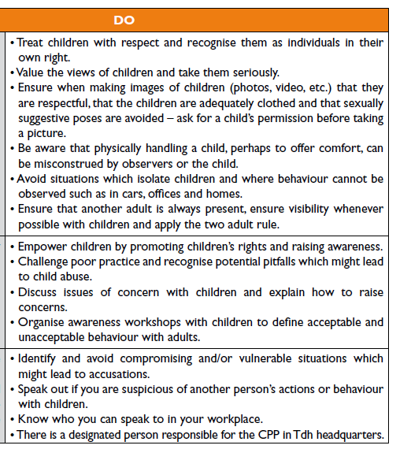
Making participation safe
Internal safeguarding code of conduct ! (example)
Notes:
Resource : psychosocial training toolkit

Slide 65
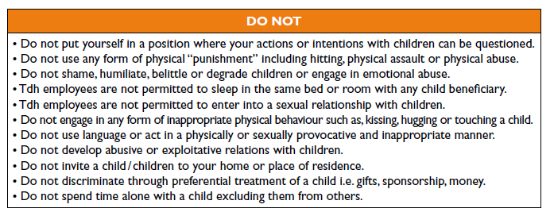
Internal safeguarding code of conduct

Slide 66

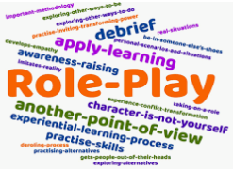
Role plays ! (handout H6a)
Notes:
Scenario 1:
A 10 year old boy who usually attends CFS activities and is being active, appears to the session glum, but he sits with the rest of the group, following the instructions and engaging in the activity. Today’s session is all about mapping my safety network. While children are drawing different places where people live or gather together, the 10 year old boy draws a home and puts a red “X” on it. You notices it while passing by and facilitating the activity.
Scenario 2:
You are introducing children to today’s activity, explaining the ground rules, the objectives and the goal of the session. A 12 year old girl, interrupts all the time, commenting, asking questions sometimes irrelevant of the topic and bothering other children in the group making difficult for you to complete and move on. It is not the first time you notice such a behavior, but you feel that this time is more intense and disturbing for the team.
Scenario 3:
You are very excited about the session you are facilitating today and you introducing the activity to children, feeling vigorous. A 9 yearold boy has different opinion and starts shouting “This is boring”, “I have done it before”. You try kindly to motivate him, continuing with the exercise but he seems not to change his attitude, insisting and disoriented other children as well. Now he already feels annoyed because nothing is good enough.
Scenario 4:
Today you are running a session with the adolescents on harassment and you have a group of girls who attend. The activity aims at expressing “safe” and “unsafe” feeling. You introduce the girls to the topic and start the activity, asking them to write in a paper what makes me feel safe and what makes me feel unsafe and put it in a paper box. After that you write in a flipchart all the answers for discussing and debriefing on key messages. While reading the papers you unfold one that writes “My neighbor makes me feel unsafe”. You feel awkward, looking around.

Slide 67
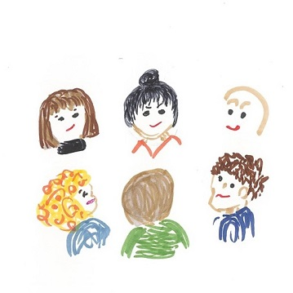
Emotional Safety
When working with a group of children, we need to balance the best interests of each child with the best interests of all the children.
It should be remembered that these are activities in increasing the involvement of children in their own protection – not a therapy group.
Children’s participation should be discussed with families and communities in advance of activities taking place to ensure that adults are supportive of the initiative.

Slide 68
Leading sensitive Discussions
Address topics in a sensitive way.
Talk about and explore topics using language that is appropriate for the age and developmental stage of children in a non-threatening way.
Know how to handle disclosures in a supportive and appropriate way.
Be able and to deal with strong emotions and feelings.
Give clear messages to children about their rights to protection, and what is and is not appropriate behaviour.
Discuss issues in a calm and clear way.
Share their concerns and seek and receive support and supervision when necessary.
Appropriately manage confidentiality.
Notes:
Role Playing on Disclosure and Sensitive Issues
Groups of three: Facilitator- Child-Observer
4 different scenarios (pending)
Role Playing-Note Taking-Discussion in groups- open Discussions

Slide 69
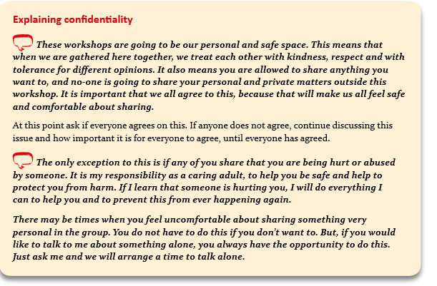
Ensuring and explain confidentiality

Slide 70
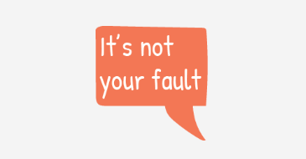
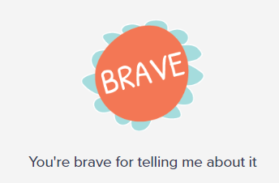
Dealing with Disclosure
Handling disclosures of abuse in a sensitive way can be the first step in the healing process for a child.
The facilitators should be aware of how to handle a disclosure and make sure they have identified and are informed properly about the referral pathways for reporting concerns

Slide 71
Making participation safe
Dealing with disclosure
Reassure the child that they are right to speak out and be protected
Listen to what the child says and give them space to talk without pressuring them.
Show your concern for the child.
Ensure that you make a referral/seek support.
Encourage the child to speak in private, rather than in the larger group.

Slide 72
Making participation Safe- Dealing with Disclosure
Show shock, amazement or disbelief about what the child is saying
Cross question or investigate the situation – your role is to listen.
Ignore what has been said or decide that it has not happened or that nothing can be done.
Blame the child for what has happened.
Pass judgement on the abuser, as children may feel very loyal.

Slide 73
Dealing with challenging behaviors Specific to Protection
Try not to get into battle about what is right or what is wrong
If a child starts to disclose or becomes upset, encourage them to talk in private to one of the trainers, rather that speaking openly in the wider group
Don’t give mixed messages
If one of the participants has strong opinion and dominates the group, try to encourage quieter participants or ask them to share into groups
Notes:
Open tables discussions:
Try not to get into a battle about what is right and wrong – even if you don’t agree with a child, you can always empathise with their views and feelings. Try and encourage children to do this with each other, too.
• If a child starts to disclose or becomes upset, encourage them to talk in private to one of the trainers, rather than speaking openly in the wider group. They may share information that they later wish they had not.
• Don’t give mixed messages. For example, you cannot talk about good and bad touch and then not respect children’s boundaries. Encourage other children to be respectful. Similarly you cannot tell children it is a safe space, and then make them talk about things they do not want to talk about or participate in exercises they do not feel comfortable doing.
• If one member of the group has strong opinions and dominates the group, encourage quieter participants to share their views or break into small groups so that other children’s voices can be heard.
Make sure the limits of confidentiality are explained in the ground rules at the start:
information may need to be shared with other adults if you are concerned about a child’s safety or well-being.
Don’t seek information on personal experiences of abuse. You are running a training course, not conducting therapy or counselling.
Be prepared for disclosure and know how to respond and where to get support.

Slide 74
Distribute handout 6

Slide 75

Practice !
Notes:
2 session of the curriculum are proposed to other particpants

Slide 76
Key messages after Action
What main feedback?

Slide 77

Practical Considerations For organizing sessions with children
Venue
Meeting times
Privacy
First aid
Preparation time
Equipment/ material
Water-refreshments
Presence of other adults

Slide 78
How to Select Participants ?
How to Mobilise adolescents ?
It is important that participants are selected on the basis of being children (under18 years old).
it may be appropriate to run separate workshops for girls and boys, but this should be avoided.
It is necessary to carefully consider the age range in each group
Another issue to think about is the number of children attending the workshops.
Children’s participation must be voluntary.
Share practice on mobilization on adolescents (outreach, get to know session, explain process to the adolescents)
Notes:
Selection of Participants & Trainers
Participants
1. It is important that participants are selected on the basis of being children (under18 years old). No child should be excluded because of a disability or other reason, such as lack of education. If it is felt that the child will not be able to participate, for example, because they will not be able to take part in an activity if they have a physical disability, then the exercise should be changed or additional support given so that the child can be included.
2. Very occasionally and in special circumstances where there are strong taboos about the mixing of older children for cultural or religious reasons, it may be appropriate to run separate workshops for girls and boys, but this should be avoided.
3. It is necessary to carefully consider the age range in each group, as children have more in common the closer they are in age. A maximum range of three to four years in a group is advisable, if possible. This also means that activities can be designed or adapted to appeal to the age of the children.
4. Another issue to think about is the number of children attending the workshops. It is difficult to work with more than 20 children in a session. While it is good to have enough children so that there is an exchange of ideas, it is equally important to make sure that there is time and space for everyone to participate and have their voice heard. If a lot of children want to participate, a better idea may be to hold two or three training sessions at the same time (if possible) and separate the children into groups. Ideally a training group should have between 12 and 15 participants.
5. Children’s participation must be voluntary. They should be told in advance what the workshop is about and what its purpose is. Nobody should be ‘made’ to attend (although children who are shy made need to be encouraged). Children should also be free to leave, or not attend the following sessions. However, if children decide that they do not want to continue it is always useful to ask why. Many times, the reasons why children are unhappy about attending can be easily solved.

Slide 79
How to select facilitators ?
All trainers, in addition to being able to work with children, MUST have previous training in core child protection awareness as a minimum.
At least two, preferably three facilitators (with a mix of male and female trainers) should work with each group
Notes:
• When selecting trainers it is important to remember that their role is to facilitate the involvement and learning of the participants. It is useful to consider the qualities of a good facilitator and decide if the potential trainer can meet most, if not all, of these. All trainers, in addition to being able to work with children, MUST have previous training in core child protection awareness as a minimum.
• At least two, preferably three facilitators (with a mix of male and female trainers) should work with each group, as this increases the chance of being able to develop a good relationship with children. This also helps if there is a problem, as one of the facilitators can resolve this while the other carries on with the session.

Slide 80
Choosing activities for enhancing safeguarding for children
Deciding which activities to include depends on:
Children’s psychosocial need
Children’s resources and capabilities
Appropriate to culture and social norms
Children’s best interests
Notes:
Children’s psychosocial needs: the activities should be carefully chosen to address the issues that are challenging the children.
Children’s resources and capabilities: the activities chosen must be suitable for the specific ages and capabilities of the children
Appropriate to culture and social norms: the activities should be appropriate and acceptable in the children’s daily cultural and social environment. For example, in some cultures it is inappropriate that boys and girls participate in activities together where they have close physical contact.
Children’s best interests: All activities that are held with the children should be in their best interest. If there is a risk of negative repercussions as a result of any activity, then that activity should be left out or replaced with another more appropriate activity

Slide 81
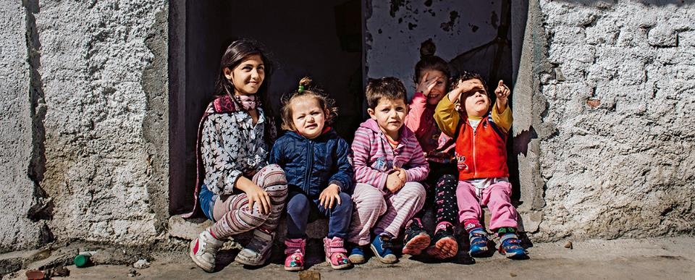
©Tdh/G.Medina - Albania
Evaluation and closure

Slide 82
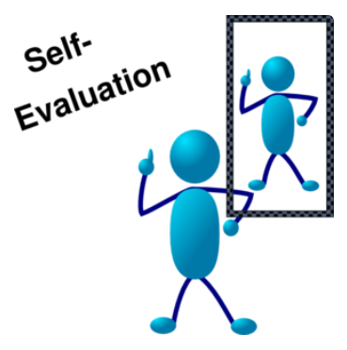
Self-Evaluation on facilitation skills
Notes:
Remenber to ask participants to put the same number on their post test, than their did for the pre test…

Slide 83

Proposed Pre-post test for measuring knowledge gained after the training
Notes:
Remenber to ask participants to put the same number on their post test, than their did for the pre test…

Slide 84

Evaluation of the training
Are you on board ?
Notes:
Participative evaluation of the training

