Slide 1
The Child Protection Hub
An interactive and collaborative initiative for child protection actors
www.childhub.org
Child Hub unlocks potential of thousands of child protection actors by delivering innovative services, content and tools that can help them achieve positive changes for children.

Slide 2
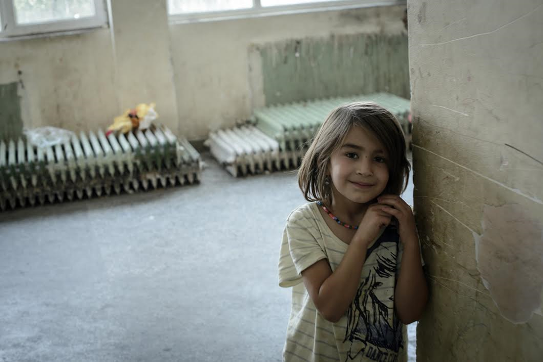
Concept of the ChildHub: problems at the start
1 billion children victims of violence
1 in 3 adolescents bullied at school in Europe
Lifetime impact

Slide 3
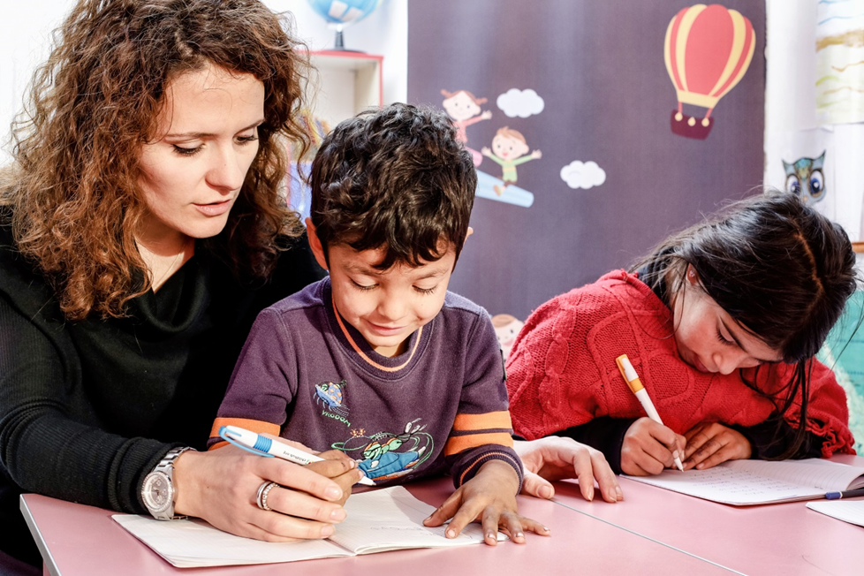
Concept of the ChildHub: problems at the start
Lack of multisector approach
Inefficient Collaborations
Insufficient training, support, motivation of professionals
Impact on the quality of services

Slide 4
The ChildHub solution
A Regional Community of Practices combining traditional face-to-face means with latest digital solutions

Slide 6
Who We Are
Regional Management: 2 persons
Part-time Associates in 8 countries
100 volunteers and interns
229 Resource Persons
6,400 child protection professionals
230,000 visitors on 1,020,077 webpages
Collaborative, multi-partners and multi-disciplinary: +10 universities, +15 NGOs, government representatives, etc
Multi-lingual: English, Romanian, Bulgarian, Albanian, Hungarian, SCB languages
+ Russian & Ukrainian

Slide 8
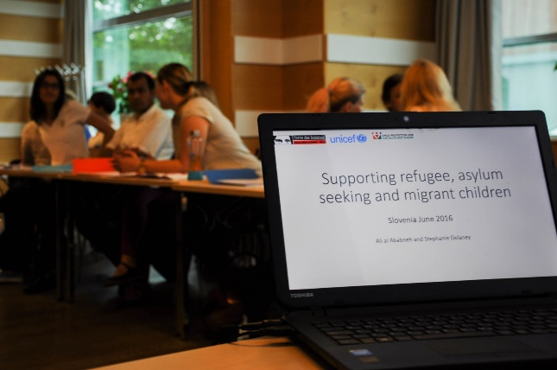
Combined face to face and digital community of practices
Digital
Regional
National
Online Library
3 Research and thematic reports
8 national studies
92 newsletters
3 Annual Conferences
24 National Round Tables
8 e-learnings
Regional ToT
26 local trainings
84 webinars
43 case discussions
Regional exchange visits
National advocacy

Slide 9
RESULTS 2015-2019
500 people trained face-to-face
70 trainers trained
468 people trained in the context of refugee crisis
3,400 attended ChildHub offline events
2,200+ people attended 80 webinars
Webinars:
91% satisfaction level
6400 members
400 people attended 43 case discussions
230,000 visitors to the childhub.org
A multilingual online library
of 2745 items
3 research and thematic papers
229 Resource persons mobilized in 8 countries
100 volunteers and interns (research, communications, translations)
86% of professionals say ChildHub has improved their connections, cooperation, and level of knowledge
8 online courses in the ChildHub Academy

Slide 10
SUCCESSES
Change attitudes and behaviors in consuming information, accessing training and collaborations online
Large adoption of academics
Expansion
Connections across sectors and countries
Continous learning
Blended opportunities
Customization and globalization
Agility, flexibility, responsiveness

Slide 11
What ChildHub users say
“I manage to get informed about issues that directly interest me, but also learn about totally new subjects”
“This platform is very interesting and helpful for professional and experts dealing with Child Protection and working with children. The resources cover a wide range of topics for every level and interest of the users of this platform”
“It is very important for me that ChildHub offers the opportunity to interact with professionals from other countries in the region, but also from (my country), and to share the experience we have”

Slide 12
CHALLENGES
Centralization vs Community driven: quality management?
Motivations for horizontal exchanges / User generated knowledge
More cutting edge technologies
Translations
Economic model
Sustainability

Slide 13
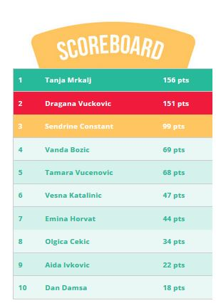
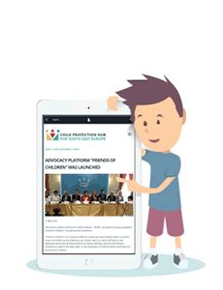
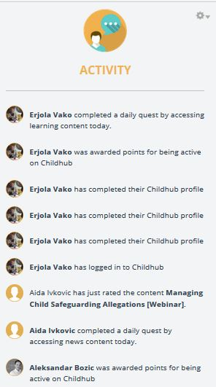
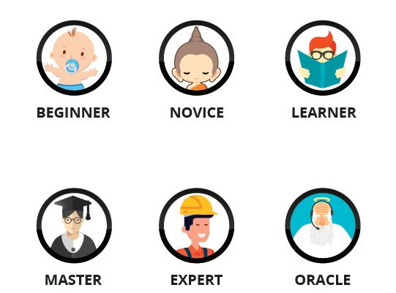
Visibility of other user’s actions
Gamification: game-like features in a professional setting
Healthy „competition”
Collecting points, badges, advancing on levels
Calls to actions and instant feedback

Slide 14
Planned Developments
New technologies and design
A deep learning model using artificial intelligence
Dynamic Partnerships strategy
A platform for social innovation
Geographical expansion
Thematic expansions
New Economic Model

Slide 15
Child Protection Hub for South East Europe
www.childhub.org

Slide 16
budget
3 YEARS - 8 countries - 5 languages | EUR
TOTAL COSTS | 1 700 000
Online platform and products | 200 000 | 12%
Face to Face Activities | 760 000 | 45%
Management/ staff costs in field | 590 000 | 35%
Indirect costs, Evaluation, etc | 150 000 | 9%

Slide 18
International Child Safeguarding through ICT
Digital Tools to tackling worst form of child labour

Slide 19
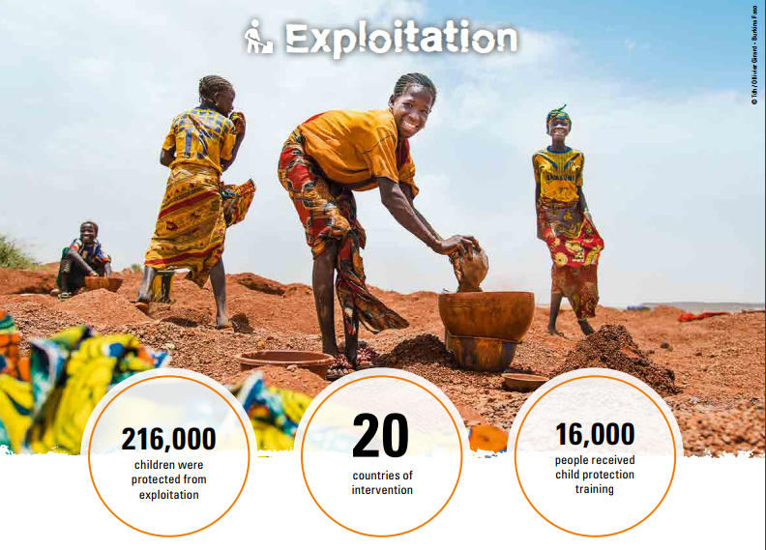
Our Goal 2020

Slide 20
Our Innovative Model interventions
SAP and SaVa

Slide 21
SAP - The project in a nutshell
Name: Early Warning System (EWS) and monitoring of the human right violations, and in particular child rights, in artisanal gold mines
Intervention zone: Ganzourgou Province, Burkina Faso
Duration: 2 years
Partners:
Tdh
Protection services at national, regional and local levels
Communities
DIMAGI

Slide 22
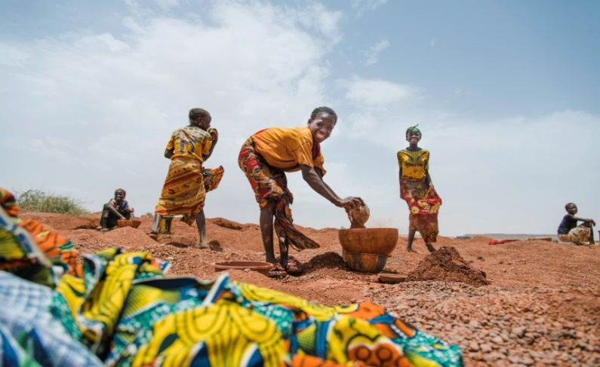
Early Warning System in gold mining sites in Burkina Faso
Collecting information
Processing information
Intervening
Continuous Information System
Evidence-base advocacy to political decision-makers and private sector
Community collection officers on gold mining sites
Data
Management System
Protection Services
If incidents
Early Warning System
Police
Improvement of protection service accessibilty
SMS
Health Services

Slide 23
SaVa- the project in a nutshell
Name: SaVa (Safe Saving – securid saving)
Intervention area: Lomé, Togo
Duration: 12 months, pilot phase
Partners:
Tdh
MAEJT in Togo (AEJT-DE)
Ecobank

Slide 24
More specifically
To establish a dynamic saving network via Ecobank application to respond to street children needs
To develop a child-led action-research

Slide 25
How does it work?
1. Open a bank account
SIM Card for children
Open a bank account through Tdh
Point Espoir
SIM Card in Point Espoir or by children themselves

Slide 26
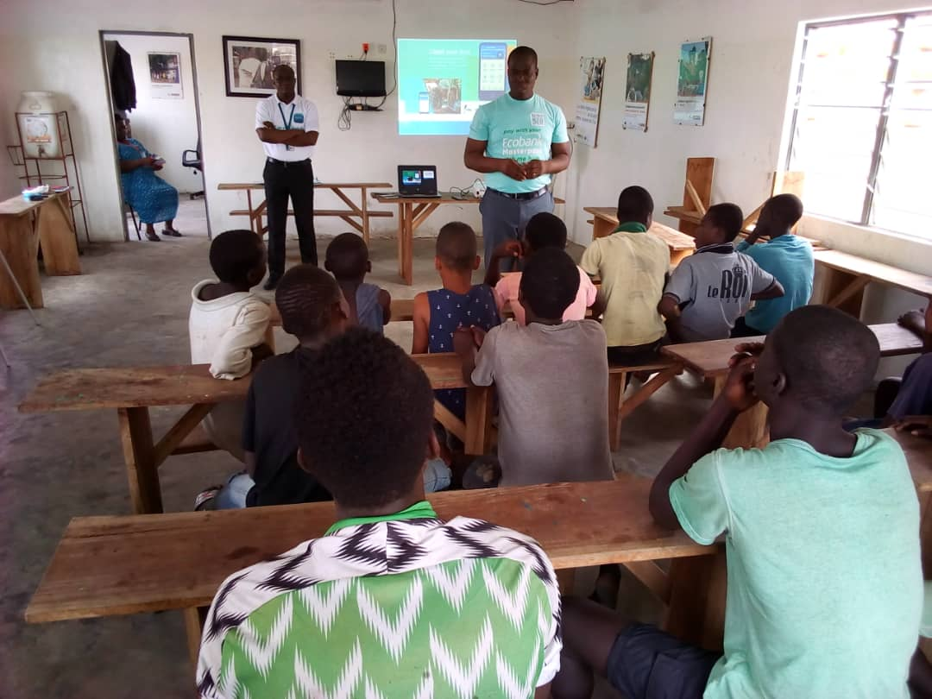
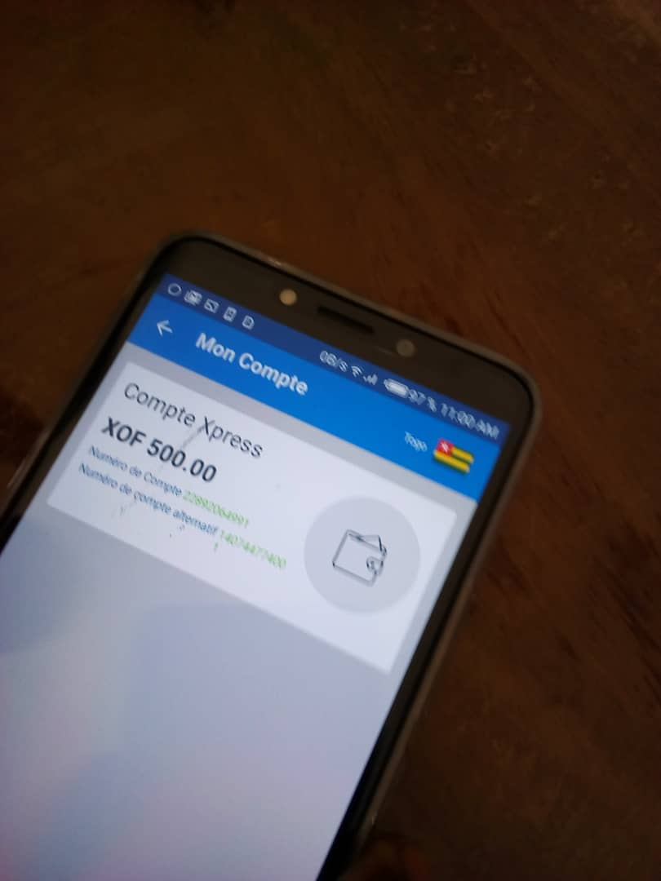
How does it work?
2. storage
Carte SIM child
Smartphone Point Espoir
Point Xpress
Smartphone Point Espoir
Cash child
Point Xpress

Slide 27
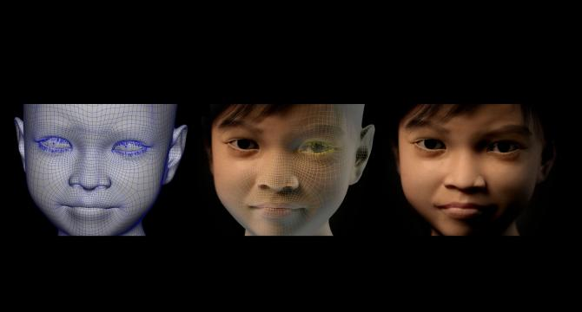
Sweetie 2.0
A virtualized child
chatbot facility and 3D imagery
🡪mapping
🡪 measuring 🡪combating
child sexual abuse

Slide 28
pedophiles”)
Summary
Sweetie 1.0- 2013
Highlight the phenomenon
Sweetie 2.0 2016
What we achieved
Brainstorming

Slide 29
pedophiles”)
Sweetie 1.0 – 2013
4 researchers, 10 weeks
Well over 20,000 contacts (20,172)
1,000 perpetrators identified
71 different countries
Handed over to law enforcement

Slide 30
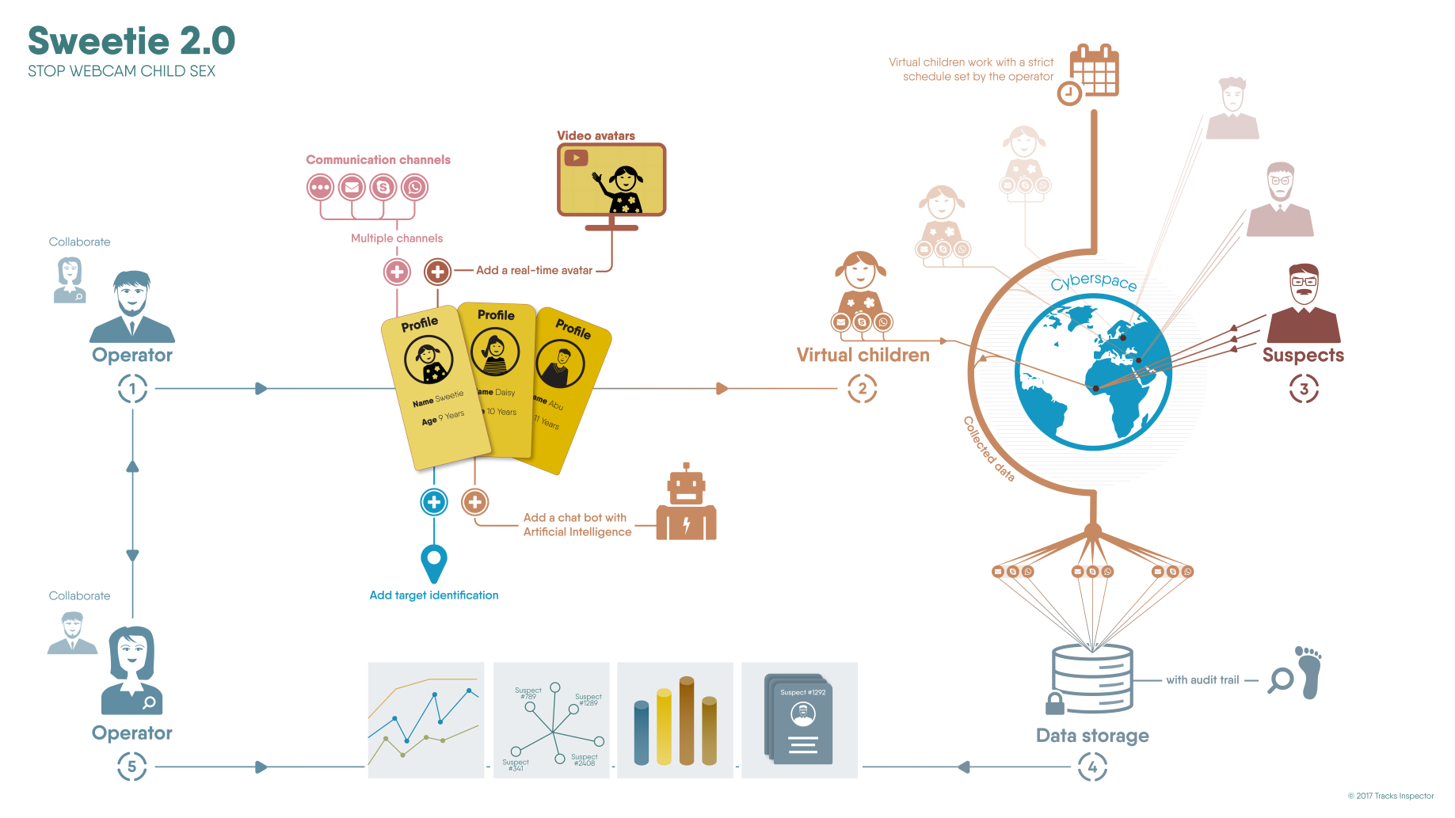

Slide 31
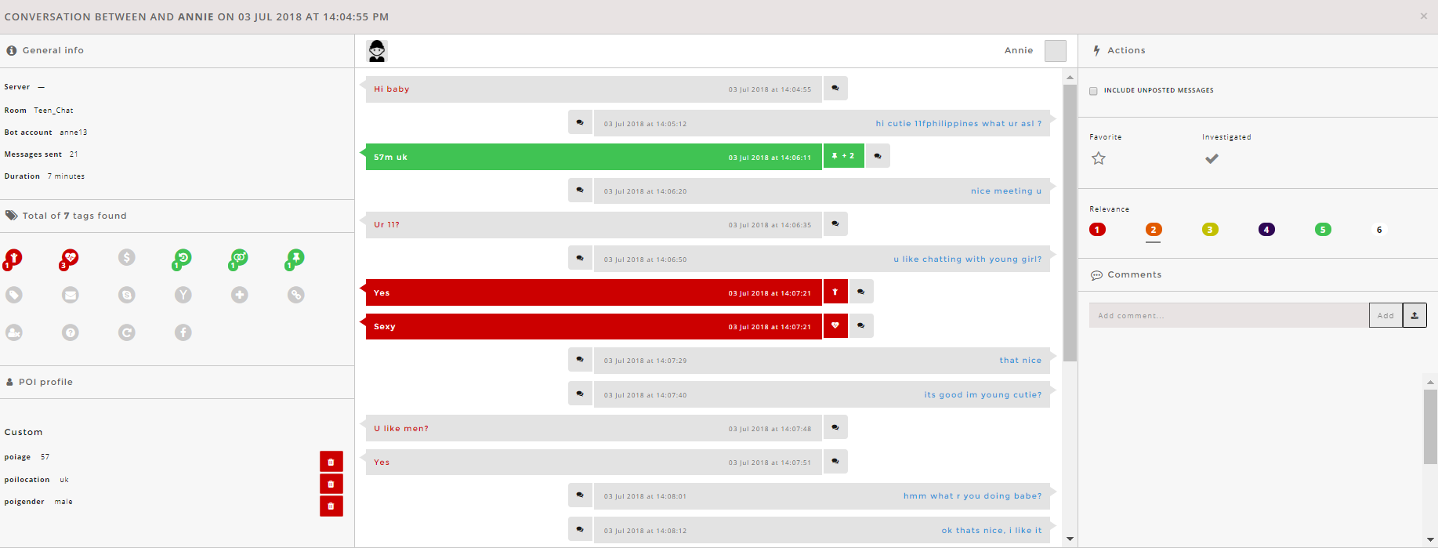

Slide 32
What we achieved
LE agencies

Slide 33
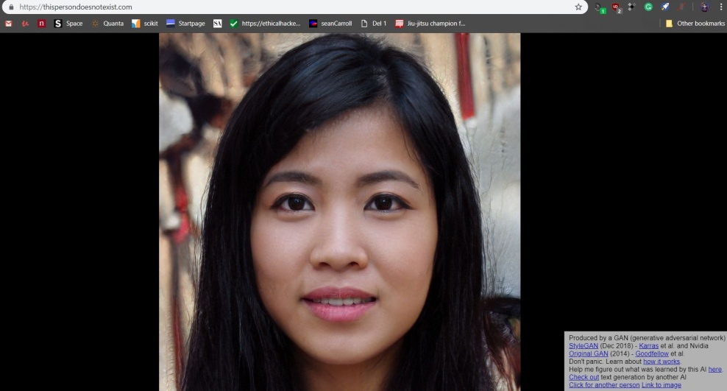
Brainstorming
🡪AI improved (Avatar and chatscript)
🡪Audio recording (Google assistant)
🡪This person does not exist
🡪Predictive policing?

Slide 34
Failure is an option here. If things are not failing, you are not innovating enough. Elon Musk

